Slide 1
Software Defined Networking
6CS029 Advanced Networks
Notes:
Long gone are the days when a single vendor, such as IBM, could provide an enterprise with all the products and services required by their information technology (IT) department, including computer hardware, system software, applications software, and communications and networking equipment and services. Today, users and enterprises face complex, heterogeneous and diverse environments that require sophisticated and advanced solutions.
The focus of session is to look at some of the networking technologies that enable the design, development, deployment, and operation of complex modern networks, including and especially software-defined networks (SDN), network functions virtualization (NFV), quality of service (QoS), and quality of experience (QoE).

Slide 2
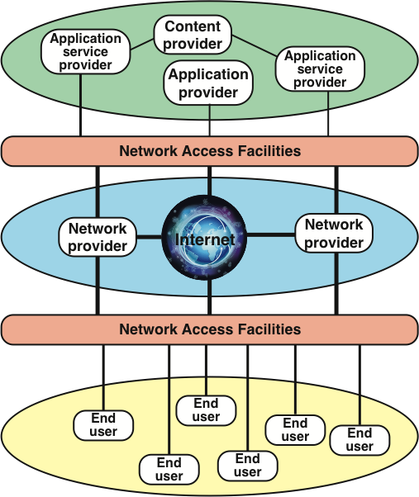
The Modern Networking Ecosystem
e.g. Web, email and DB servers
ADSL, DSL, Mobile, ethernet etc
Notes:
The figure depicts the modern networking ecosystem in very general terms. The entire ecosystem exists to provide services to end users. The term end user, or simply user, is used here as a very general term, to encompass users working within an enterprise or in a public setting or at home. The user platform can be fixed (for example, PC or workstation), portable (for example, laptop), or mobile (for example, tablet or smartphone).
Users connect to network-based services and content through a wide variety of network access facilities. These include digital subscriber line (DSL) and cable modems, Wi-Fi and WiMAX wireless modems, and cellular modems. Such network access facilities enable the use to connect directly to the Internet or to a variety of network providers, including Wi-Fi networks, cellular networks, and both private and shared network facilities, such as a premises enterprise network.
Ultimately, of course, users want to use network facilities to access applications and content. Application providers provide applications, or apps, that run on the user’s platform, which is typically a mobile platform. More recently, the concept of an app store is also available for fixed and portable platforms as well. A distinct category of provider is the application service provider. Whereas the application provider downloads software to the user’s platform, the application service provider acts as a server or host of application software that is executed on the provider’s platforms. Traditional examples of such software include web servers, e-mail servers, and database servers. The most prominent example now is the cloud computing provider.
The final element is the content provider. A content provider serves the data to be consumed on the user device (for example, e-mail, music, video). This data may be commercially provided intellectual property. In some instances, an enterprise may be an application or content provider. Examples of content providers are music and video streaming platforms.
The figure is intended to provide a very general depiction of the networking ecosystem. It is worth pointing out here two major elements of modern networking not explicitly depicted in this figure:
Data center networking: Both large enterprise data centers and cloud provider data centers consist of very large numbers of interconnected servers. Typically, as much as 80 percent of the data traffic is within the data center network, and only 20 percent relies on external networks to reach users.
IoT or fog networking: An Internet of Things deployed by an enterprise may consist of hundreds, thousands, even millions of devices. The vast bulk of the data traffic to and from these devices is machine to machine, rather than user to machine.Each of these networking environments creates its own particular requirements, which are discussed as the book progresses.

Slide 3
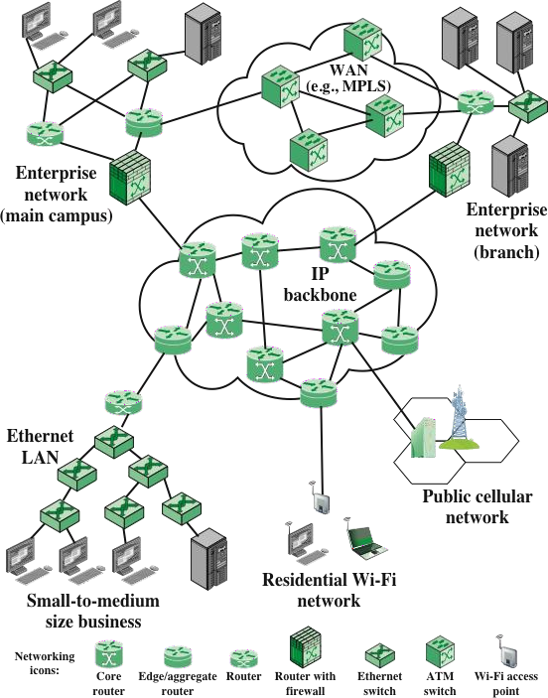
A Global Network Architecture
Internet or an enterprise IP network of high-performance core routers interconnected by high-speed links
Notes:
At the center of the figure is an IP backbone, or core, network, which could represent a portion of the Internet or an enterprise IP network. Typically, the backbone consists of high-performance routers, called core routers, interconnected with high-volume optical links.
At the periphery of an IP backbone are routers that provide connectivity to external networks and users. These routers are sometimes referred to as edge routers or aggregation routers. Aggregation routers are also used within an enterprise network to connect a number of routers and switches, to external resources, such as an IP backbone or a high-speed WAN.
As an indication of the capacity requirements for core and aggregation routers, the IEEE Ethernet Bandwidth Assessments Group reports on an analysis that projects these requirements for Internet backbone providers and large enterprise networks in China. The analysis concludes that aggregation router requirements will be in the range of 200 Gbps to 400 Gbps per optical link by 2020, and 400 Gbps to 1 Tbps per optical link for core routers by 2020.
The upper part of Figure 1.2 depicts a portion of what might be a large enterprise network. The figure shows two sections of the network connected via a private high-speed WAN, with switches interconnected with optical links. MPLS using IP is a common switching protocol used for such WANs; wide-area Ethernet is another option. Enterprise assets are connected to, and protected from, an IP backbone or the Internet via routers with firewall capability, a not uncommon arrangement for implementing the firewall.
The lower left of the figure depicts what might be a layout for a small- or medium-size business, which relies on an Ethernet LAN. Connection to the Internet through a router could be through a cable or DSL connection or a dedicated high-speed link. The lower portion of Figure 1.2 also shows an individual residential user connected to an Internet service provider (ISP) through some sort of subscriber connection. Common examples of such a connection are a DSL, which provides a high-speed link over telephone lines and requires a special DSL modem, and a cable TV facility, which requires a cable modem, or some type of wireless connection. In each case, there are separate issues concerning signal encoding, error control, and the internal structure of the subscriber network.Finally, mobile devices, such as smartphones and tablets, can connect to the Internet through the public cellular network, which has a high-speed connection, typically optical, to the Internet.

Slide 4
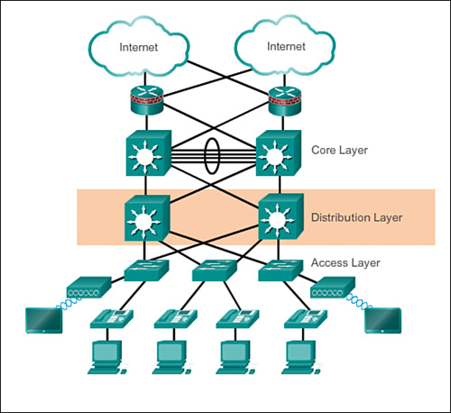
A Typical Network Hierarchy
Access layer: Provides workgroup/user access to the network
Distribution layer: Provides policy-based connectivity and controls the boundary between the access and core layers
Core layer: Provides fast transport between distribution switches within the enterprise campus
Notes:
The access layer serves a number of functions, including
Layer 2 switching
High availability
Port security
QoS classification and marking and trust boundaries
Address Resolution Protocol (ARP) inspection
Virtual access control lists (VACLs)
Spanning tree
Power over Ethernet (PoE) and auxiliary VLANs for VoIP
The distribution layer can provide
Aggregation of LAN or WAN links.
Policy-based security in the form of access control lists (ACLs) and filtering.
Routing services between LANs and VLANs and between routing domains (e.g., EIGRP to OSPF).
Redundancy and load balancing.
A boundary for route aggregation and summarization configured on interfaces toward the core layer.
Broadcast domain control, because routers or multilayer switches do not forward broadcasts. The device acts as the demarcation point between broadcast domains.
The core should be highly available and redundant. The core aggregates the traffic from all the distribution layer devices, so it must be capable of forwarding large amounts of data quickly.
Considerations at the core layer include
Providing high-speed switching (i.e., fast transport)
Providing reliability and fault tolerance
Scaling by using faster, and not more, equipment
Avoiding CPU-intensive packet manipulation caused by security, inspection, quality of service (QoS) classification, or other processes

Slide 5
Ethernet
Predominant wired networking technology
Supports distances from a few meters to tens of kilometres
Has evolved to support data rates up to 100 Gbps
Has become essential for supporting personal computers, workstations, servers, and massive data storage devices in organisations large and small
Notes:
Key network transmission technologies include Ethernet, Wi-Fi, and 4G/5G cellular networks. Each of these technologies has evolved to support very high data rates. These data rates support the many multimedia applications required by enterprises and consumers and, at the same time, place great demands on network switching equipment and network management facilities.
Ethernet is the predominant wired networking technology, used in homes, offices, data centers, enterprises, and WANs. As Ethernet has evolved to support data rates up to 100 Gbps and distances from a few meters to tens of kilometers, it has become essential for supporting personal computers, workstations, servers, and massive data storage devices in organizations large and small.
Ethernet in the Home
Ethernet has long been used in the home to create a local network of computers with access to the Internet via a broadband modem/router. With the increasing availability of high-speed, low-cost Wi-Fi on computers, tablets, smartphones, modem/routers, and other devices, home reliance on Ethernet has declined. Nevertheless almost all home networking setups include some use of Ethernet.

Slide 6
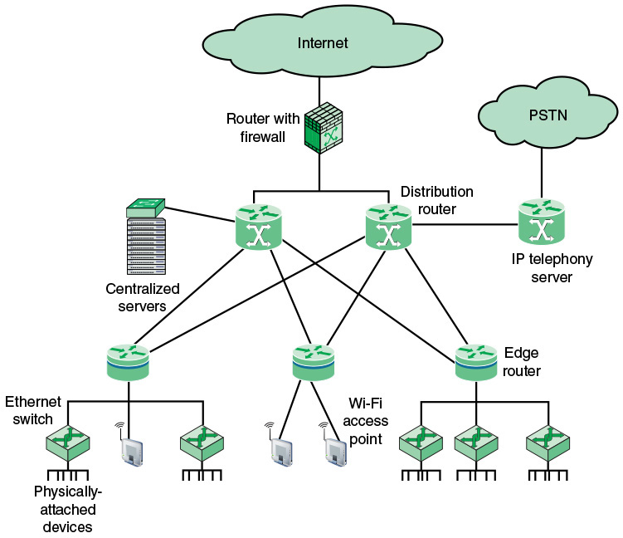
Ethernet in the Office
A Basic Enterprise LAN Architecture
Notes:
A tremendous advantage of Ethernet is that it is possible to scale the network, both in terms of distance and data rate, with the same Ethernet protocol and associated quality of service (QoS) and security standards. An enterprise can easily extend an Ethernet network among a number of buildings on the same campus or even some distance apart, with links ranging from 10 Mbps to 100 Gbps, using a mixture of cable types and Ethernet hardware. Because all the hardware and communications software conform to the same standard, it is easy to mix different speeds and different vendor equipment. The same protocol is used for intensive high-speed interconnections of data servers in a single room, workstations and servers distributed throughout the building, and links to Ethernet networks in other buildings up to 100 km away.

Slide 7
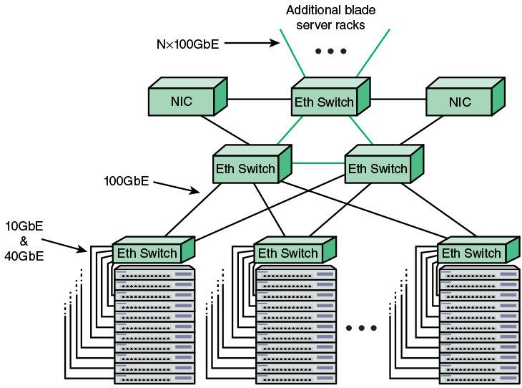
Ethernet in the Data Centre
very high data rates are needed to handle massive volumes of data among networked servers and storage units
Notes:
As in other areas, Ethernet has come to dominate in the data center, where very high data rates are needed to handle massive volumes of data among networked servers and storage units. Historically, data centers have employed various technologies to support high-volume, short-distance needs, including InfiniBand and Fiber Channel. But now that Ethernet can scale up to 400 Gbps, the case for a unified protocol approach throughout the enterprise is compelling. Two features of the new Ethernet approach are noteworthy. For co-located servers and storage units, high-speed Ethernet fiber links and switches provided the needed networking infrastructure. Another important version of Ethernet is known as backplane Ethernet. Backplane Ethernet runs over copper jumper cables that can provide up to 100 Gbps over very short distances. This technology is ideal for blade servers, in which multiple server modules are housed in a single chassis.
5G systems available since 2020, the huge amounts of data traffic generated by tablets and smartphones will be augmented by an equally huge, and perhaps much larger, amount of traffic from the Internet of Things, which includes shoes, watches, appliances, cars, thermostats, door locks, and much more.

Slide 8
Evolving Network Requirements
A number of trends are driving network providers and users to reevaluate traditional approaches to network architecture
Demand is increasing
Supply is increasing
Dynamic and complex traffic patterns
“horizontal” traffic between servers as well as “vertical” traffic
between servers and clients.
Elastic – not affected by delay Jitter etc. Typical traffic
Inelastic traffic – VOIP, Multimedia etc
unpredictable traffic patterns of voice, data, and video
Unified communications (UC) strategies – use of cloud etc to provide video conferencing
Notes:
A number of trends are driving network providers and users to reevaluate traditional approaches to network architecture
Demand is increasing
Cloud computing and Big data
Mobile traffic and The Internet of Things (IoT)
Supply is increasing
As the demand on networks is rising, so is the capacity of network technologies to absorb rising load
Dynamic and complex traffic patterns
“horizontal” traffic between servers as well as “vertical” traffic
between servers and clients.
unpredictable traffic patterns, often of large multimedia data
transfers due to network convergence of voice, data, and video
Unified communications (UC) strategies involve heavy use of applications that trigger access to multiple servers.
Elastic Traffic
Can adjust, over wide ranges, to changes in delay and throughput across an internet and still meet the needs of its applications
Is the traditional type of traffic supported on TCP/IP based internets
Is the type of traffic for which internets were designed
Applications that generate such traffic typically use Transmission Control Protocol (TCP) or User Datagram Protocol (UDP) as a transport protocol
Inelastic Traffic
Does not easily adapt, if at all, to changes in delay and throughput across an internet
Examples of inelastic traffic include: multimedia transmission such as voice and video, and high- volume interactive traffic
Requirements may include:
Throughput
Delay
Delay jitter

Slide 9
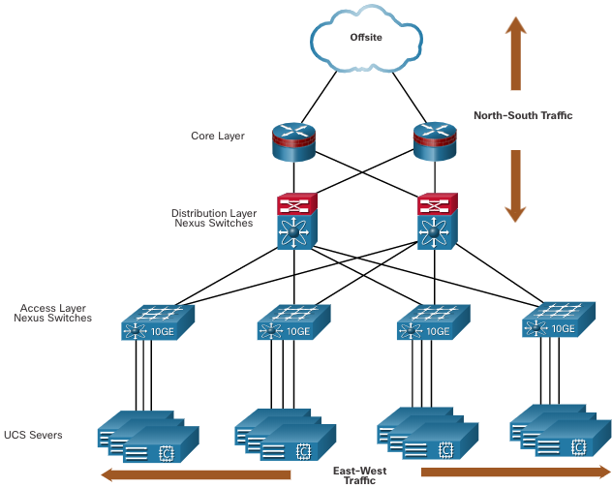
Virtual Network Infrastructure
Server virtualization hides server resources.
VMs are movable (hence large data shifts) and the network must change to support their mobility.
Traffic flows differ from the traditional client-server model.
Network functions can be virtualized (VLANS etc)
Notes:
The Complexity of Network Virtualization
There is increasingly widespread use of server virtualization. In essence, server virtualization masks server resources, including the number and identity of individual physical servers, processors, and operating systems, from server users. This makes it possible to partition a single machine into multiple, independent servers, conserving hardware resources. It also makes it possible to quickly migrate a server from one machine to another for load balancing or for dynamic switchover in the case of machine failure. Server virtualization has become a central element in dealing with big data applications and in implementing cloud computing infrastructures. But it creates problems with traditional network architectures. One problem is configuring virtual LANs. Network managers need to make sure the VLAN used by the virtual machine (VM) is assigned to the same switch port as the physical server running the VM. But with the VM being movable, it is necessary to reconfigure the VLAN every time that a virtual server is moved. In general terms, to match the flexibility of server virtualization, the network manager needs to be able to dynamically add, drop, and change network resources and profiles. This is difficult to do with conventional network switches, in which the control logic for each switch is collocated with the switching logic.
Another effect of server virtualization is that traffic flows differ substantially from the traditional client/server model. Typically, there is a considerable amount of traffic among virtual servers, for such purposes as maintaining consistent images of database and invoking security functions such as access control. These server-to-server flows change in location and intensity over time, demanding a flexible approach to managing network resources.
Another factor leading to the need for rapid response in allocating network resources is the increasing use by employees of mobile devices, such as smartphones, tablets, and notebooks to access enterprise resources. These devices can add fast-changing and unpredictable large loads on the network, and can rapidly change their network attachment point. Network managers must be able to respond to rapidly changing resource, QoS, and security requirements for mobile devices. Existing network infrastructures can respond to changing requirements for the management of traffic flows, providing differentiated QoS levels and security levels for individual flows, but the process can be very time-consuming if the enterprise network is large or involves network devices from multiple vendors.
The network manager must configure each vendor’s equipment separately, and adjust performance and security parameters on a per-session, per-application basis. In a large enterprise, every time a new VM is brought up, it can take hours or even days for network managers to do the necessary reconfiguration.
The network infrastructure can also benefit from virtualization. Network functions can be virtualized. Each network device can be segmented into multiple virtual devices that operate as independent devices. Examples include subinterfaces, virtual interfaces, VLANs, and routing tables. Virtualized routing is called virtual routing and forwarding (VRF).

Slide 10
Quality of Experience (QoE)
A subjective measure of performance as reported by the
user; relies on human opinion
Is important particularly when dealing with multimedia applications and multimedia content delivery
QoS processes by themselves are not sufficient in that they do not take into account the user’s perception of network performance and service quality
Categories of factors and features that can be included in QoE are:
Perceptual - For video, examples include sharpness, brightness, contrast, flicker, and distortion
Psychological ease of use, joy of use, usefulness, perceived quality, satisfaction, annoyance, and boredom
Interactive between the user and the application or device, such as responsiveness, naturalness of interaction, communication efficiency, and accessibility
Notes:
Quality of Experience
QoE is a subjective measure of performance as reported by the user. Unlike QoS, which can be precisely measured, QoE relies on human opinion. QoE is important particularly when we deal with multimedia applications and multimedia content delivery. QoS provides measurable, quantitative targets that guide the design and operation of a network and enable customer and provider to agree on what quantitative performance the network will deliver for give applications and traffic flows.
However, QoS processes by themselves are not sufficient in that they do not take into account the user’s perception of network performance and service quality. Although the maximum capacity may be fixed at a certain value by a media transmission system, this does not necessarily fix the quality of the multimedia content at, say, “high.” This is because there are numerous ways the multimedia content could have been encoded, giving rise to differing perceived qualities. The ultimate measure of a network and the services it offers is how subscribers perceive the performance. QoE augments the traditional QoS by providing information regarding the delivered services from an end user point of view.
There is a wide range of factors and features that can be included in a requirement for QoE, which can be:
Perceptual: This category encompasses the quality of the sensory aspects of the user experience. For video, examples include sharpness, brightness, contrast, flicker, and distortion. Audio examples include clarity and timbre.
Psychological: This category deals with the user’s feeling about the experience. Examples include ease of use, joy of use, usefulness, perceived quality, satisfaction, annoyance, and boredom.
Interactive: This category deals with aspects of an experience related to the interaction between the user and the application or device, such as responsiveness, naturalness of interaction, communication efficiency, and accessibility.
For practical application, these features need to be converted to quantitative measures. The management of QoE has become a crucial concept in the deployment of future successful applications, services, and products. The greatest challenges in providing QoE are developing effective methods for converting QoE features to quantitative measures and translating QoE measures to QoS measures. Whereas QoS can now easily be measured, monitored, and controlled at both the networking and application layers, and at both the end system and network sides, QoE is something that is still quite intricate to manage.

Slide 11
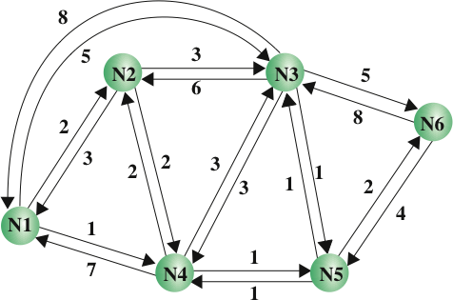
Routing Characteristics
The primary function of an internet is to accept packets from a source station and deliver them to a destination station
Selection of a route is generally based on some performance criterion
Notes:
Characteristics
The primary function of an internet is to accept packets from a source station and deliver them to a destination station. To accomplish this, a path or route through the network must be determined; generally, more than one route is possible. Therefore, a routing function must be performed.The selection of a route is generally based on some performance criterion. The simplest criterion is to choose the minimum-hop route (one that passes through the least number of nodes) through the network. This is an easily measured criterion and should minimize the consumption of network resources. A generalization of the minimum-hop criterion is least-cost routing. In this case, a cost is associated with each link, and, for any pair of attached stations, the route through the network that accumulates the least cost is sought.Figure 2.7 illustrates a network in which the two arrowed lines between a pair of nodes represent a link between these nodes, and the corresponding numbers represent the current link cost in each direction. Our concern, of course, is with an internet, in which each node is a router and the links between adjacent routers are networks or direct communications links. The shortest path (fewest hops) from node 1 to node 6 is 1-3-6 (Cost = 5 + 5 = 10), but the least-cost path is 1-4-5-6 (Cost = 1 + 1 + 2 = 4).

Slide 12
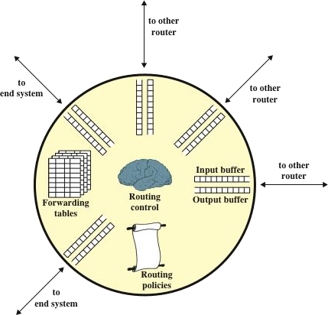
Elements of a Router
Packet forwarding
Routing protocols
Congestion control
Notes:
Packet Forwarding The key function of any router is to accept incoming packets and forward them. For this purpose, a router maintains forwarding tables. A router’s forwarding table shows, for each destination, the identity of the next node on the router. Each router may be responsible for discovering the appropriate routes. Alternatively, a network control center may be responsible for designing routes for all routers and maintaining a central forwarding table, providing each router with individual forwarding tables relevant only to that router.
Routers are responsible for receiving and forwarding packets through the interconnected set of networks
Each router makes routing decisions based on knowledge of the topology and traffic/delay conditions of the internet
A degree of dynamic cooperation is needed among the routers
The router must avoid portions of the network that have failed and should avoid portions of the network that are congested
If the traffic demand on an internet exceeds capacity, or if the internet does not manage the traffic efficiently, congestion will occur.
There are several schemes implemented in the networking devices to control congestion some of which are linked to the QoS we discussed last time.

Slide 13
Traditional Network Architectures
As QoS and QoE requirements imposed on the network are expanded as a result of the variety of applications, the traffic load must be handled in an increasingly sophisticated and agile fashion
The traditional internetworking approach is based on the TCP/IP protocol architecture; characteristics of this approach are:
Two-level end system addressing
Routing based on destination
Distributed, autonomous control
The Open Networking Foundation (ONF) cites four general limitations of traditional network architectures:
Static, complex architecture
Inconsistent policies
Inability to scale
Vendor dependence
Notes:
To summarise, Traditional Network Architectures are inadequate because :

Slide 14
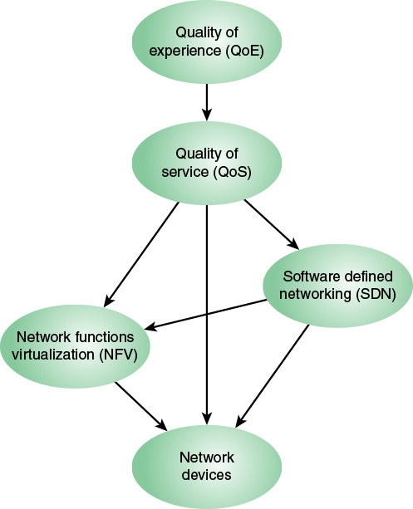
Modern Approach to Networking
Networks need to be more adaptable and scalable.
Two key technologies are rapidly being deployed by a variety of network service and application providers
Software-Defined Networking (SDN) and
Network Functions Virtualization (NFV)
Notes:
With the ever-increasing volume and variety of network traffic, generated by such high-demand sources as big data, cloud computing, and mobile traffic, it becomes increasingly difficult to meet stringent QoS and QoE requirements. Networks need to be more adaptable and scalable. To provide adaptability and scalability, two key technologies that are rapidly being deployed by a variety of network service and application providers are software-defined networking (SDN) and network functions virtualization (NFV).
SDN has reached a tipping point at which it is replacing the traditional networking model. Software-defined networks provide an enhanced level of flexibility and customizability to meet the needs of newer networking and IT trends such as cloud, mobility, social networking, and video.
Ultimately, the concern of a network service provider is about the set of network devices (such as routers) and the control and management of the functions they perform (such as packet forwarding). If NFV is used, these network functions are implemented in software and executed on VMs. If instead the network functions are implemented on dedicated machines and SDN is used, the control functions are implemented on central SDN controllers, which interact with the network devices.However, SDN and NFV are not mutually exclusive. If both SDN and NFV are implemented for a network, the following relationships hold: Network data plane functionality is implemented on VMs. The control plane functionality may be implemented on a dedicated SDN platform or on an SDN VM.In either case, the SDN controller interacts with the data plane functions running on VMs.QoS measures are commonly used to specify the service required by various network customers or users and to dictate the traffic management policies used on the network. The common case, until recently, is that QoS was implemented on network that used neither NFV nor SDN. In this case, routing and traffic control policies must be configured directly on network devices using a variety of automated and manual techniques. If NFV but not SDN is implemented, the QoS settings are communicated to the VMs. With SDN, regardless of whether NFV is used, it is the SDN controller that is responsible for enforcing QoS parameters for the various network users.If QoE considerations come into play, these are used to adjust QoS parameters to satisfy the users’ QoE requirements.

Slide 15
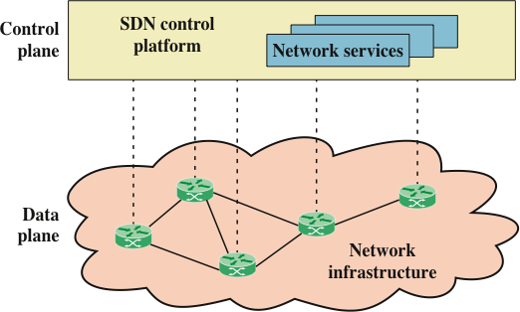
Software Defined Networking
Notes:
The two elements involved in forwarding packets through routers are a control function, which decides the route the traffic takes and the relative priority of traffic, and a data function, which forwards data based on control-function policy. Prior to SDN, these functions were performed in an integrated fashion at each network device (router, bridge, packet switch, and so on). Control in such a traditional network is exercised by means of a routing and control network protocol that is implemented in each network node. This approach is relatively inflexible and requires all the network nodes to implement the same protocols. With SDN, a central controller performs all complex functionality, including routing, naming, policy declaration, and security checks

Slide 16
The SDN Approach- Requirements
Adaptability – respond dynamically based on needs
Automation- policy changes propagated automatically
Maintainability- seamless introduction of patches etc
Model management- changing network model without manually reconfiguring devices
Mobility – must accommodate mobile devices, virtual servers etc.
Integrated security – not an add on solution
On-demand scaling – can increase or decrease services
Notes:
How is SDN designed to meet evolving network requirements?
Requirements
Based on the narrative of previous slides, we are now in a position to detail the principal requirements for a modern networking approach. The Open Data Center Alliance (ODCA) provides a useful, concise list of requirements, which include the following [ODCA14]:
Adaptability: Networks must adjust and respond dynamically, based on application needs, business policy, and network conditions.
Automation: Policy changes must be automatically propagated so that manual work and errors can be reduced.
Maintainability. Introduction of new features and capabilities (software upgrades, patches) must be seamless with minimal disruption of operations.
Model management: Network management software must allow management of the network at a model level, rather than implementing conceptual changes by reconfiguring individual network elements.
Mobility: Control functionality must accommodate mobility, including mobile user devices and virtual servers.
Integrated security: Network applications must integrate seamless security as a core service instead of as an add-on solution.
On-demand scaling: Implementations must have the ability to scale up or scale down the network and its services to support on-demand requests.

Slide 17
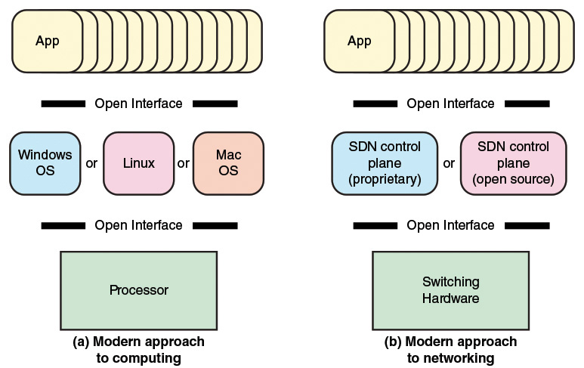
SDN Architecture – analogy with computing systems
Notes:
An analogy can be drawn between the way in which computing evolved from closed, vertically integrated, proprietary systems into an open approach to computing and the evolution coming with SDN (see Figure 3.1). In the early decades of computing, vendors such as IBM and DEC provided a fully integrated product, with a proprietary processor hardware, unique assembly language, unique operating system (OS), and the bulk if not all of the application software. In this environment, customers, especially large customers, tended to be locked in to one vendor, dependent primarily on the applications offered by that vendor. Migration to another vendor’s hardware platform resulted in major upheaval at the application level.
Today, the computing environment is characterized by extreme openness and great customer flexibility. The bulk of computing hardware consists of x86 and x86-compatible processors for standalone systems and ARM processors for embedded systems. This makes it easy to port operating systems implemented in C, C++, Java, and the like. Even proprietary hardware architectures, such as IBM’s zEnterprise line, provide standardized compilers and programming environments and so can easily run open sources operating systems such as Linux. Therefore, applications written for Linux or other open operating systems can easily be moved from one vendor platform to another. Even proprietary systems such as Windows and Mac OS provide programming environments to make porting of applications an easy matter. It also enables the development of virtual machines that can be moved from one server to another across hardware platforms and operating systems.The networking environment today faces some of the same limitations faced in the pre-open era of computing. Here the issue is not developing applications that can run on multiple platforms. Rather, the difficulty is the lack of integration between applications and network infrastructure. As demonstrated in the preceding section, traditional network architectures are inadequate to meet the demands of the growing volume and variety of traffic.

Slide 18
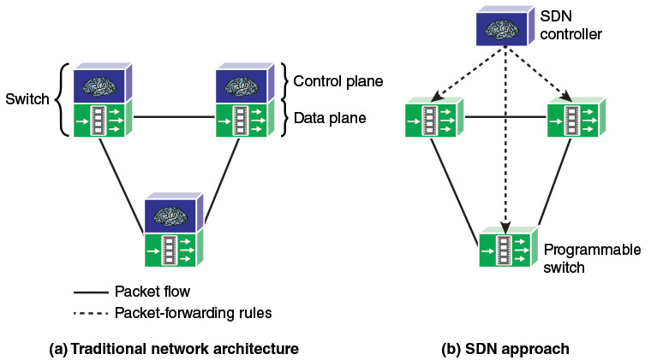
SDN Architecture
Control abstracting away from devices
Control at device level
Notes:
The central concept behind SDN is to enable developers and network managers to have the same type of control over network equipment that they have had over x86 servers. As discussed the SDN approach splits the switching function between a data plane and a control plane that are on separate devices (see Figure 3.2). The data plane is simply responsible for forwarding packets, whereas the control plane provides the “intelligence” in designing routes, setting priority and routing policy parameters to meet QoS and QoE requirements and to cope with the shifting traffic patterns. Open interfaces are defined so that the switching hardware presents a uniform interface regardless of the details of internal implementation. Similarly, open interfaces are defined to enable networking applications to communicate with the SDN controllers.

Slide 19
Control Plane and Data Plane
A network device contains the following planes:
Control plane
is used to make forwarding decisions.
Info sent to this plane is processed by the CPU
The control plane contains Layer 2 and Layer 3 route forwarding mechanisms
protocol neighbor tables
topology tables,
IPv4 and IPv6 routing tables,
STP, and the ARP table.
Data plane (forwarding plane)
typically the switch fabric connecting the various network ports on a device.
used to forward traffic flows. Routers and switches use information from the control plane to forward incoming traffic out the appropriate egress interface.
Information in the data plane is typically processed by a special data plane processor without the CPU getting involved.
Notes:
Example CEFCisco Express Forwarding is an advanced, Layer 3 IP switching technology that enables forwarding of packets to occur at the data plane without consulting the control plane.
SDN is basically the separation of the control plane and data plane. The control plane function is removed from each device and is performed by a centralized controller. The centralized controller communicates control plane functions to each device. Each device can now focus on forwarding data while the centralized controller manages data flow, increases security, and provides other services.
The management plane is responsible for managing a device through its connection to the network.
Network administrators use applications such as Secure Shell (SSH), Trivial File Transfer Protocol (TFTP), Secure FTP, and Secure Hypertext Transfer Protocol (HTTPS) to access the management plane and configure a device.
The management plane is how you have accessed and configured devices in your networking studies. In addition, protocols like Simple Network Management Protocol (SNMP), use the management plane.

Slide 20
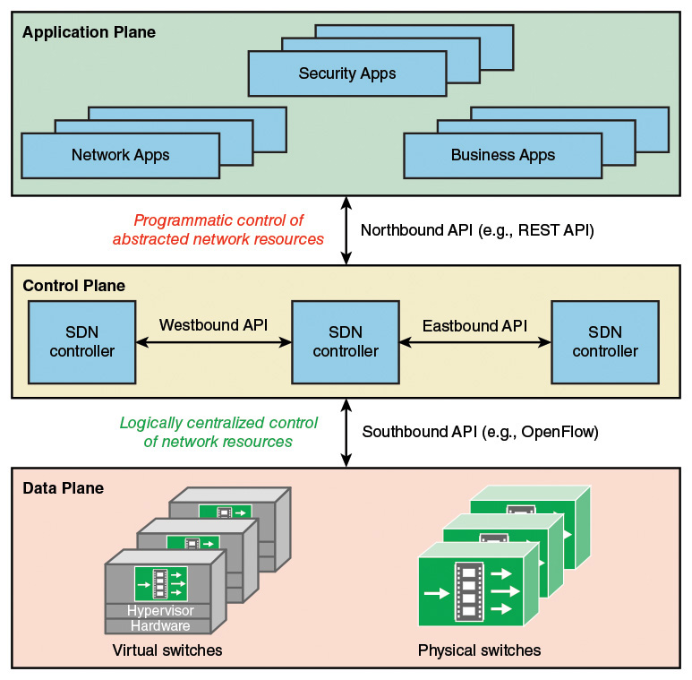
SDN Architecture
Controller implemented on a server or virtual server
API allows switch to communicate northbound packet forwarding details and controller to communicate its control instructions southbound
Notes:
This figure elaborates on the structure showing more detail of the SDN approach. The data plane consists of physical switches and virtual switches. In both cases, the switches are responsible for forwarding packets. The internal implementation of buffers, priority parameters, and other data structures related to forwarding can be vendor dependent. However, each switch must implement a model, or abstraction, of packet forwarding that is uniform and open to the SDN controllers. This model is defined in terms of an open application programming interface (API) between the control plane and the data plane (southbound API). The most prominent example of such an open API is OpenFlow, a specification that defines both a protocol between the control and data planes and an API by which the control plane can invoke the OpenFlow protocol.
OpenFlow, the most widely used implementation of the SDN data plane.
A language and message format used by an application program to communicate with the operating system or some other control program such as a database management system (DBMS) or communications protocol. APIs are implemented by writing function calls in the program, which provide the linkage to the required subroutine for execution. An open or standardized API can ensure the portability of the application code and the vendor independence of the called service.
SDN controllers can be implemented directly on a server or on a virtual server. OpenFlow or some other open API is used to control the switches in the data plane. In addition, controllers use information about capacity and demand obtained from the networking equipment through which the traffic flows. SDN controllers also expose northbound APIs, which allow developers and network managers to deploy a wide range of off-the-shelf and custom-built network applications, many of which were not feasible before the advent of SDN. As yet there is no standardized northbound API nor a consensus on an open northbound API. A number of vendors offer a REpresentational State Transfer (REST)-based API to provide a programmable interface to their SDN controller.

Slide 21
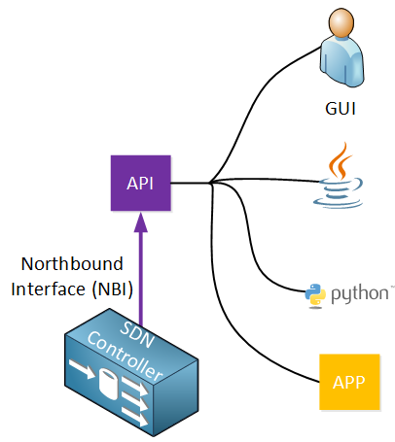
Northbound Interface
Used to access the SDN controller itself.
This allows a network administrator to access the SDN to configure it or to retrieve information from it.
use this to write scripts and automate your network administration.
List information from all network devices in your network.
Show the status of all physical interfaces in the network.
Add a new VLAN on all your switches.
Show the topology of your entire network.
Automatically configure IP addresses, routing, and access-lists when a new virtual machine is created.

Slide 22
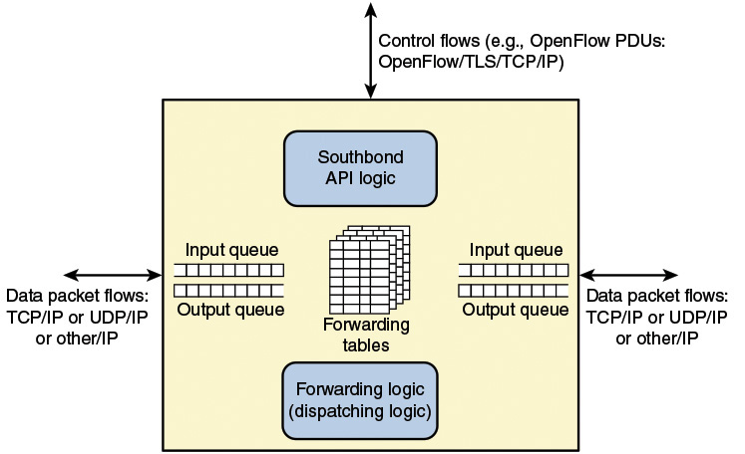
SDN - Data Plane Network Device
Switches , routers
Management / rules passed down by controller
Decision making rules defined by controller
Notes:
The SDN data plane, referred to as the resource layer in ITU-T Y.3300 and also often referred to as the infrastructure layer, is where network forwarding devices perform the transport and processing of data according to decisions made by the SDN control plane. The important characteristic of the network devices in an SDN network is that these devices perform a simple forwarding function, without embedded software to make autonomous decisions.Data Plane FunctionsFigure 4.2 illustrates the functions performed by the data plane network devices (also called data plane network elements or switches). The principal functions of the network device are the following:
Control support function: Interacts with the SDN control layer to support programmability via resource-control interfaces. The switch communicates with the controller and the controller manages the switch via the OpenFlow switch protocol.
Data forwarding function: Accepts incoming data flows from other network devices and end systems and forwards them along the data forwarding paths that have been computed and established according to the rules defined by the SDN applications.
These forwarding rules used by the network device are embodied in forwarding tables that indicate for given categories of packets what the next hop in the route should be. In addition to simple forwarding of a packet, the network device can alter the packet header before forwarding, or discard the packet. As shown, arriving packets may be placed in an input queue, awaiting processing by the network device, and forwarded packets are generally placed in an output queue, awaiting transmission.
The network device in Figure 4.2 is shown with three I/O ports: one providing control communication with an SDN controller, and two for the input and output of data packets. This is a simple example. The network device may have multiple ports to communicate with multiple SDN controllers, and may have more than two I/O ports for packet flows into and out of the device.
Data Plane Protocols
Figure 4.2 suggests the protocols supported by the network device. Data packet flows consist of streams of IP packets. It may be necessary for the forwarding table to define entries based on fields in upper-level protocol headers, such as TCP, UDP, or some other transport or application protocol. The network device examines the IP header and possibly other headers in each packet and makes a forwarding decision.
The other important flow of traffic is via the southbound application programming interface (API), consisting of OpenFlow protocol data units (PDUs) or some similar southbound API protocol traffic

Slide 23
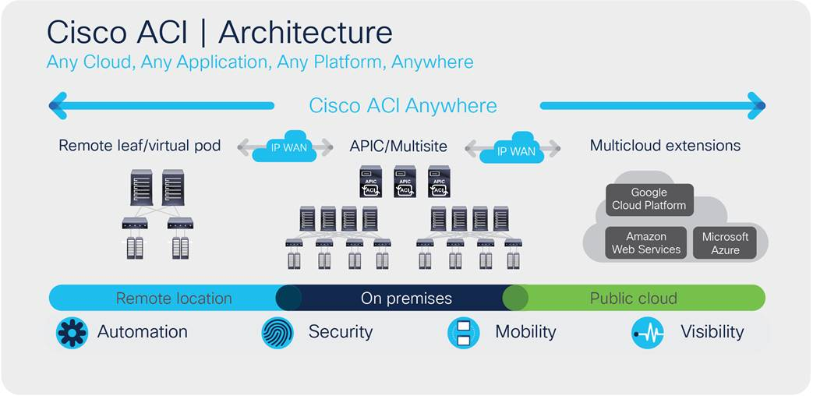
Example
Notes:
Cisco Application Centric Infrastructure (ACI) - A purpose-built hardware solution for integrating cloud computing and data center management.
Cisco ACI is an industry-leading SDN solution that provides policy-driven automation through an integrated underlay and overlay, supporting hypervisors compatible with many types of platform or operating system, and extends policy automation to any workload — including virtual machines, physical bare-metal servers, and containers.
Cisco ACI and architectural solutions are built with the following building blocks:
● Cisco Application Policy Infrastructure Controller (APIC)
● Cisco Nexus® 9000 Series spine and leaf switches for Cisco ACI

Slide 24
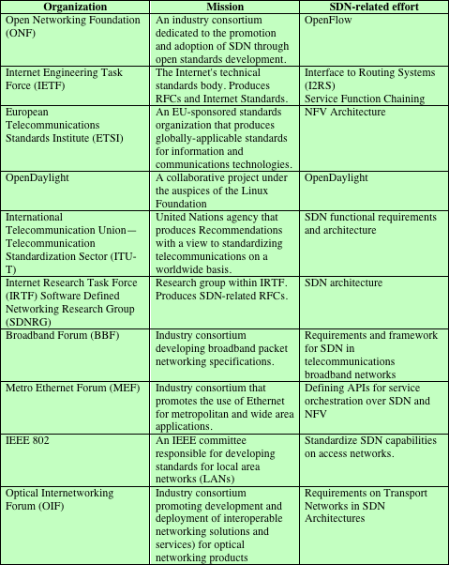
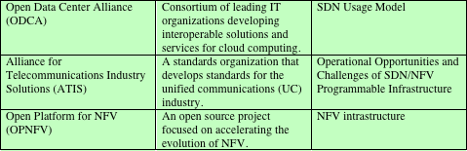
SDN and NFV Standards Activities
Notes:
Unlike some technology areas, such as Wi-Fi, there is no single standards body responsible for developing open standards for SDN and NFV. Rather, there is a large and evolving collection of standards-developing organizations (SDOs), industrial consortia, and open development initiatives involved in creating standards and guidelines for SDN and NFV. Table 3.1 lists the main SDOs and other organizations involved in the effort and the main outcomes so far produced.
Documents that provide requirements, specifications, guidelines, or characteristics that can be used consistently to ensure that materials, products, processes, and services are fit for their purpose. Standards are established by consensus among those participating in a standards-making organization and are approved by a generally recognized body.A standard that is: developed on the basis of an open decision-making procedure available to all interested parties, is available for implementation to all on a royalty-free basis, and is intended to promote interoperability among products from multiple vendors.
The Internet Engineering Task Force (IETF) has working groups developing SDN-related specifications in the following areas: Interface to routing systems (I2RS): Develop capabilities to interact with routers and routing protocols to apply routing policies. Service function chaining: Develop an architecture and capabilities for controllers to direct subsets of traffic across the network in such a way that each virtual service platform sees only the traffic it must work with.

Slide 25
OpenFlow Logical Network Device
SDN practical implementation requires:
A common logical architecture in all switches, routers, and other network devices to be managed by an SDN controller.
May be implemented in different ways as long as the SDN controller sees a uniform logical switch functionality.
A standard, secure protocol is needed between the SDN controller and the network device.
OpenFlow, an open source standard supported by many vendors
OpenFlow is both a protocol between SDN controllers and network devices and a specification of the logical structure of the network switch functionality.
OpenFlow is defined in the OpenFlow Switch Specification, published by the Open Networking Foundation (ONF).
Notes:
To turn the concept of SDN into practical implementation, two requirements must be met: There must be a common logical architecture in all switches, routers, and other network devices to be managed by an SDN controller. This logical architecture may be implemented in different ways on different vendor equipment and in different types of network devices, as long as the SDN controller sees a uniform logical switch functionality. A standard, secure protocol is needed between the SDN controller and the network device.These requirements are addressed by OpenFlow, which is both a protocol between SDN controllers and network devices and a specification of the logical structure of the network switch functionality. OpenFlow is defined in the OpenFlow Switch Specification, published by the Open Networking Foundation (ONF).

Slide 26
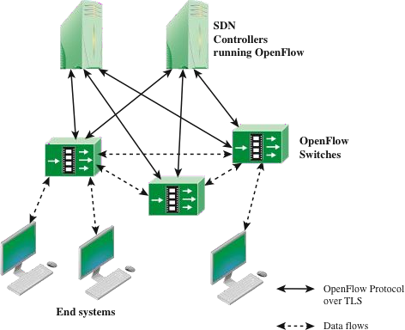
OpenFlow Switch Context
Main elements of an OpenFlow environment, consisting of SDN controllers that include OpenFlow software, OpenFlow switches, and end systems
Notes:
Figure 4.3 indicates the main elements of an OpenFlow environment, consisting of SDN controllers that include OpenFlow software, OpenFlow switches, and end systems.

Slide 27
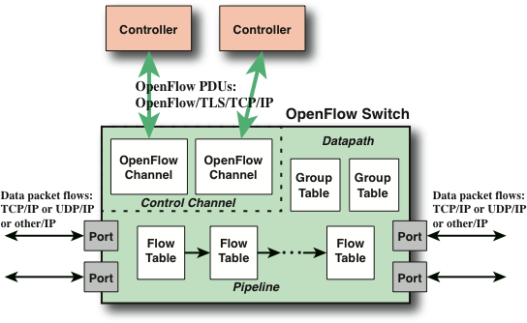
Main Components of an OpenFlow (only) Switch
Flow may be on group table which then dictates how it is handled
Ports
Physical, logical and reserved
Tables
Flow, group and meter
A flow is a sequence of packets traversing a network that share a set of header field values such as IP addresses or VLAN id
Typical of what happens when a you require any form of traffic (e.g. downloading a file)
Notes:
Figure 4.4 displays the main components of an OpenFlow switch. An SDN controller communicates with OpenFlow-compatible switches using the OpenFlow protocol running over Transport Layer Security (TLS). Each switch connects to other OpenFlow switches and, possibly, to end-user devices that are the sources and destinations of packet flows. On the switch side, the interface is known as an OpenFlow channel. These connections are via OpenFlow ports. An OpenFlow port also connects the switch to the SDN controller. OpenFlow defines three types of ports:
Physical port: Corresponds to a hardware interface of the switch. For example, on an Ethernet switch, physical ports map one to one to the Ethernet interfaces.
Logical port: Does not correspond directly to a hardware interface of the switch. Logical ports are higher-level abstractions that may be defined in the switch using non-OpenFlow methods (for example, link aggregation groups, tunnels, loopback interfaces). Logical ports may include packet encapsulation and may map to various physical ports. The processing done by the logical port is implementation dependent and must be transparent to OpenFlow processing, and those ports must interact with OpenFlow processing like OpenFlow physical ports.
Reserved port: Defined by the OpenFlow specification. It specifies generic forwarding actions such as sending to and receiving from the controller, flooding, or forwarding using non-OpenFlow methods, such as “normal” switch processing.
Within each switch, a series of tables is used to manage the flows of packets through the switch. The OpenFlow specification defines three types of tables in the logical switch architecture.
A flow table matches incoming packets to a particular flow and specifies what functions are to be performed on the packets.
There may be multiple flow tables that operate in a pipeline fashion, as explained subsequently. A flow table may direct a flow to a group table, which may trigger a variety of actions that affect one or more flows.
A meter table can trigger a variety of performance-related actions on a flow. Using the OpenFlow switch protocol, the controller can add, update, and delete flow entries in tables, both reactively (in response to packets) and proactively.
Before proceeding, it is helpful to define what is meant by the term flow. Curiously, this term is not defined in the OpenFlow specification, nor is there an attempt to define it in virtually all of the literature on OpenFlow. In general terms, a flow is a sequence of packets traversing a network that share a set of header field values. For example, a flow could consist of all packets with the same source and destination IP addresses or all packets with the same virtual LAN (VLAN) identifier. The sections that follow provide a more specific definition of this concept.

Slide 28
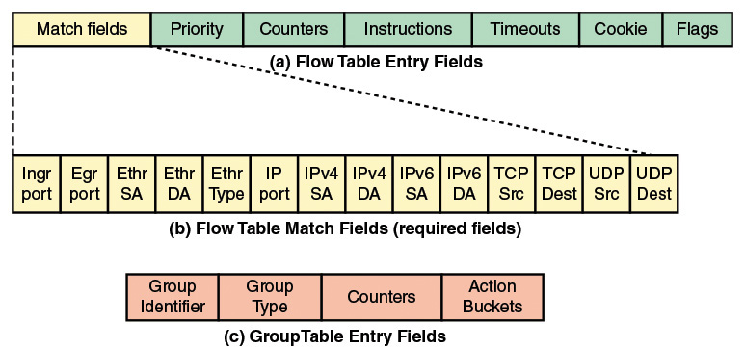
Flow Table Structure
Notes:
The basic building block of the logical switch architecture is the flow table. Each packet that enters a switch passes through one of more flow tables. Each flow table consists of a number of rows, called entries, consisting of seven components (see part a of Figure 4.5), as defined in the list that follows.
Match fields: Used to select packets that match the values in the fields.
Priority: Relative priority of table entries. This is a 16-bit field with 0 corresponding to the lowest priority. In principle, there could be 216 = 64k priority levels.
Counters: Updated for matching packets. The OpenFlow specification defines a variety of counters
Instructions: Instructions to be performed if a match occurs.
Timeouts: Maximum amount of idle time before a flow is expired by the switch. Each flow entry has an idle_timeout and a hard_timeout associated with it. A nonzero hard_timeout field causes the flow entry to be removed after the given number of seconds, regardless of how many packets it has matched. A nonzero idle_timeout field causes the flow entry to be removed when it has matched no packets in the given number of seconds.
Cookie: 64-bit opaque data value chosen by the controller. May be used by the controller to filter flow statistics, flow modification and flow deletion; not used when processing packets.
Flags: Flags alter the way flow entries are managed; for example, the flag OFPFF_SEND_FLOW_REM triggers flow removed messages for that flow entry.
Match Fields ComponentThe match fields component of a table entry consists of the following required fields (see part b of Figure 4.5): Ingress port: The identifier of the port on this switch on which the packet arrived. This may be a physical port or a switch-defined virtual port. Required in ingress tables. Egress port: The identifier of the egress port from action set. Required in egress tables. Ethernet source and destination addresses: Each entry can be an exact address, a bitmasked value for which only some of the address bits are checked, or a wildcard value (match any value). Ethernet type field: Indicates type of the Ethernet packet payload. IP: Version 4 or 6. IPv4 or IPv6 source address, and destination address: Each entry can be an exact address, a bitmasked value, a subnet mask value, or a wildcard value. TCP source and destination ports: Exact match or wildcard value. UDP source and destination ports: Exact match or wildcard value.The preceding match fields must be supported by any OpenFlow-compliant switch. The following fields may be optionally supported. Physical port: Used to designate underlying physical port when packet is received on a logical port. Metadata: Additional information that can be passed from one table to another during the processing of a packet. Its use is discussed subsequently. VLAN ID and VLAN user priority: Fields in the IEEE 802.1Q virtual LAN header. SDN support for VLANs is discussed in Chapter 8, “NFV Functionality.” IPv4 or IPv6 DS and ECN: Differentiated Services and Explicit Congestion Notification fields. SCTP source and destination ports: Exact match or wildcard value for Stream Transmission Control Protocol. ICMP type and code fields: Exact match or wildcard value. ARP opcode: Exact match in Ethernet Type field. Source and target IPv4 addresses in ARP payload: Can be an exact address, a bitmasked value, a subnet mask value, or a wildcard value. IPv6 flow label: Exact match or wildcard. ICMPv6 type and code fields: Exact match or wildcard value. IPv6 neighbor discovery target address: In an IPv6 Neighbor Discovery message. IPv6 neighbor discovery source and target addresses: Link-layer address options in an IPv6 Neighbor Discovery message. MPLS label value, traffic class, and BoS: Fields in the top label of an MPLS label stack. Provider bridge traffic ISID: Service instance identifier. Tunnel ID: Metadata associated with a logical port. TCP flags: Flag bits in the TCP header. May be used to detect start and end of TCP connections. IPv6 extension: Extension header.Thus, OpenFlow can be used with network traffic involving a variety of protocols and network services. Note that at the MAC/link layer, only Ethernet is supported. Therefore, OpenFlow as currently defined cannot control Layer 2 traffic over wireless networks.

Slide 29
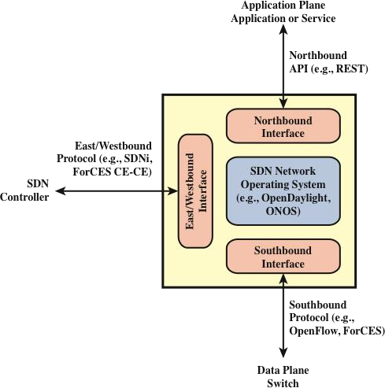
SDN Controller Interfaces
Notes:
Southbound Interface
The southbound interface provides the logical connection between the SDN controller and the data plane switches (see Figure 5.3). Some controller products and configurations support only a single southbound protocol. A more flexible approach is the use of a southbound abstraction layer that provides a common interface for the control plane functions while supporting multiple southbound APIs.
The most commonly implemented southbound API is OpenFlow,
The northbound interface enables applications to access control plane functions and services without needing to know the details of the underlying network switches. The northbound interface is more typically viewed as a software API rather than a protocol. A common architectural style used for defining northbound APIs is REpresentational State Transfer (REST)
a typical SDN controller will have an east/westbound interface that enables communication with other SDN controllers and other networks.

Slide 30
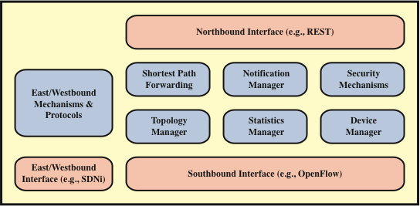
SDN Control Plane Functions and Interfaces
Uses routing information collected from switches to establish preferred routes.
Builds and maintains switch interconnection topology information
Collects Stats on data
Configures switch parameters and attributes and manages flow tables
Notes:
The SDN control layer maps application layer service requests into specific commands and directives to data plane switches and supplies applications with information about data plane topology and activity. The control layer is implemented as a server or cooperating set of servers known as SDN controllers.
The figure illustrates the essential functions that any controller should provide
Shortest path forwarding: Uses routing information collected from switches to establish preferred routes.
Notification manager: Receives, processes, and forwards to an application events, such as alarm notifications, security alarms, and state changes.
Security mechanisms: Provides isolation and security enforcement between applications and services.
Topology manager: Builds and maintains switch interconnection topology information.
Statistics manager: Collects data on traffic through the switches.
Device manager: Configures switch parameters and attributes and manages flow tables.
The functionality provided by the SDN controller can be viewed as a network operating system (NOS). As with a conventional OS, an NOS provides essential services, common application programming interfaces (APIs), and an abstraction of lower-layer elements to developers. The functions of an SDN NOS, such as those in the preceding list, enable developers to define network policies and manage networks without concern for the details of the network device characteristics, which may be heterogeneous and dynamic. The northbound interface, discussed subsequently, provides a uniform means for application developers and network managers to access SDN service and perform network management tasks. Further, well-defined northbound interfaces enable developers to create software that is independent not only of data plane details but to a great extent usable with a variety of SDN controller servers.
A number of different initiatives, both commercial and open source, have resulted in SDN controller implementations. The following list describes a few prominent ones:
OpenDaylight An open source platform for network programmability to enable SDN, written in Java. OpenDaylight was founded by Cisco and IBM, and its membership is heavily weighted toward network vendors. OpenDaylight can be implemented as a single centralized controller, but enables controllers to be distributed where one or multiple instances may run on one or more clustered servers in the network.
Open Network Operating System (ONOS)
POX
Beacon and others

Slide 31
Routing
Traditionally the routing function is distributed among the routers in a network
In an SDN controlled network, it makes sense to centralize the routing function within the SDN controller
The controller can develop a consistent view of the network state for calculating shortest paths and can implement application aware routing policies
The data plane switches are relieved of the processing and storage burden associated with routing, leading to improved performance
The centralized routing application performs two distinct functions:
Link discovery
Topology manager
Notes:
As with any network or internet, an SDN network requires a routing function. In general terms, the routing function comprises a protocol for collecting information about the topology and traffic conditions of the network, and an algorithm for designing routes through the network.
Recall from previous lessons that there are two categories of routing protocols: interior router protocols (IRPs) that operate within an autonomous system (AS), such as RIP, OSPF, and exterior router protocols (ERPs) that operate between autonomous systems (BGP).
Traditionally, the routing function is distributed among the routers in a network. Each router is responsible for building up an image of the topology of the network. For interior routing, each router as well must collect information about connectivity and delays and then calculate the preferred route for each IP destination address. However, in an SDN-controlled network, it makes sense to centralize the routing function within the SDN controller. The controller can develop a consistent view of the network state for calculating shortest paths, and can implement application-aware routing policies. The data plane switches are relieved of the processing and storage burden associated with routing, leading to improved performance.The centralized routing application performs two distinct functions: link discovery and topology manager.
For link discovery, the routing function needs to be aware of links between data plane switches. Note that in the case of an internetwork, the links between routers are networks, whereas for Layer 2 switches, such as Ethernet switches, the links are direct physical links. In addition, link discovery must be performed between a router and a host system and between a router in the domain of this controller and a router in a neighboring domain. Discovery is triggered by unknown traffic entering the controller’s network domain either from an attached host or from a neighboring router.
The topology manager maintains the topology information for the network and calculates routes in the network. Route calculation involves determining the shortest path between two data plane nodes or between a data plane node and a host.

Slide 32
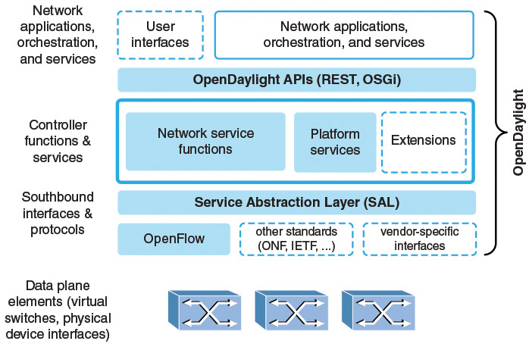
OpenDaylight SDN controller
Notes:
The OpenDaylight Project is an open source project hosted by the Linux Foundation and includes the involvement of virtually every major networking organization, including users of SDN technology and vendors of SDN products. Rather than hammer out new standards, the project aims to produce an extensible, open source, virtual networking platform atop such existing standards as OpenFlow. The approach of OpenDaylight is to enable industry participants to come together to develop core open source modules collaboratively, around which participants can add unique value. The goal is a common and open SDN platform for developers to utilize, contribute to, and build commercial products and technologies upon.
It is worthwhile to examine OpenDaylight in some detail, as it gives the reader a good idea of the scope of functionality of a typical SDN controller.
Network applications, orchestration, and services: Consists of business and network logic applications that control and monitor network behavior. These applications use the controller to gather network intelligence, run algorithms to perform analytics, and then use the controller to orchestrate the new rules, if any, throughout the network.
APIs: A set of common interfaces to OpenDaylight controller functions. OpenDaylight supports the Open Service Gateway Initiative (OSGi) framework and bidirectional REST for the northbound API. The OSGi framework is used for applications that will run in the same address space as the controller, while the REST (web-based) API is used for applications that do not run in the same address space (or even necessarily on the same machine) as the controller.
Controller functions and services: SDN control plane functions and services.
Service abstraction layer (SAL): Provides a uniform view of data plane resources, so that control plane functions can be implemented independent of the specific southbound interface and protocol.
Southbound interfaces and protocols: Supports OpenFlow, other standard southbound protocols, and vendor-specific interfaces.
There are several noteworthy aspects to the OpenDaylight architecture. First, OpenDaylight encompasses both control plane and application plane functionality. Thus, OpenDaylight is more than just an SDN controller implementation. This enables enterprise and telecommunications network managers to host open source software on their own servers to construct an SDN configuration. Vendors can use this software to create products with value-added additional application plane functions and services.
A second significant aspect of the OpenDaylight design is that it is not tied to OpenFlow or any other specific southbound interface. This provides greater flexibility in constructing SDN network configurations. The key element in this design is the SAL, which enables the controller to support multiple protocols on the southbound interface and provide consistent services for controller functions and for SDN applications.
the most recent release of OpenDaylight is the aluminium release

Slide 33
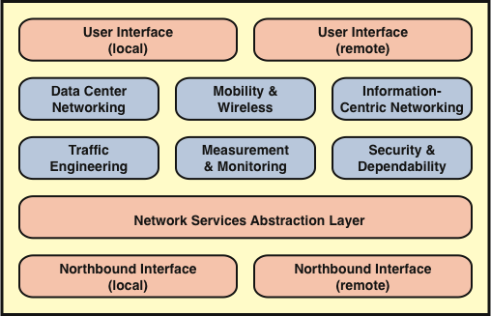

SDN Application Plane
Typical applications used on SDN
provides an abstract view of network resources that hides the details of the underlying data plane devices
Notes:
The power of the software-defined networking (SDN) approach to networking is in the support it provides for network applications to monitor and manage network behavior. The SDN control plane provides the functions and services that facilitate rapid development and deployment of network applications.
The application plane contains applications and services that define, monitor, and control network resources and behavior. These applications interact with the SDN control plane via application-control interfaces, for the SDN control layer to automatically customize the behavior and the properties of network resources. The programming of an SDN application makes use of the abstracted view of network resources provided by the SDN control layer by means of information and data models exposed via the application-control interface.
the northbound interface enables applications to access control plane functions and services without needing to know the details of the underlying network switches. Typically, the northbound interface provides an abstract view of network resources controlled by the software in the SDN control plane.
Network Services Abstraction Layer provides service abstractions that can be used by applications and services. This layer could provide an abstract view of network resources that hides the details of the underlying data plane devices.
Network Applications There are many network applications that could be implemented for an SDN. Different published surveys of SDN have come up with different lists and even different general categories of SDN-based network applications. Figure 6.1 includes six categories that encompass the majority of SDN applications.
User Interface The user interface enables a user to configure parameters in SDN applications and to interact with applications that support user interaction. Again, there are two possible interfaces. A user that is collocated with the SDN application server (which may or may not include the control plane) can use the server’s keyboard/display. More typically, the user would log on to the application server over a network or communications facility.

Slide 34
Network Functions Virtualization (NFV)
Motivation
New network services may require additional different types of hardware appliances
New hardware means additional capital expenditures.
Skills necessary to design, integrate, and operate increasingly complex hardware-based appliances
Hardware-based appliances rapidly reach end of life
The need for an increasing variety of hardware platforms inhibits the introduction of new revenue-earning network services
The NFV approach moves away from dependence on a variety of hardware platforms to the use of a small number of standardized platform types, with virtualization techniques used to provide the needed network functionality.
Notes:
NFV originated from discussions among major network operators and carriers about how to improve network operations in the high-volume multimedia era. The group listed as the overall objective of NFV is leveraging standard IT virtualization technology to consolidate many network equipment types onto industry standard high-volume servers, switches, and storage, which could be located in data centers, network nodes, and in the end-user premises. The source of the need for this new approach is that networks include a large and growing variety of proprietary hardware appliances, leading to the following negative consequences:
New network services may require additional different types of hardware appliances, and finding the space and power to accommodate these boxes is becoming increasingly difficult. New hardware means additional capital expenditures. Once new types of hardware appliances are acquired, operators are faced with the rarity of skills necessary to design, integrate, and operate increasingly complex hardware-based appliances. Hardware-based appliances rapidly reach end of life, requiring much of the procure-design-integrate-deploy cycle to be repeated with little or no revenue benefit. As technology and services innovation accelerates to meet the demands of an increasingly network-centric IT environment, the need for an increasing variety of hardware platforms inhibits the introduction of new revenue-earning network services.
The NFV approach moves away from dependence on a variety of hardware platforms to the use of a small number of standardized platform types, with virtualization techniques used to provide the needed network functionality. In the white paper, the group expresses the belief that the NFV approach is applicable to any data plane packet processing and control plane function in fixed and mobile network infrastructures.In addition to providing a way to overcome the problems cited in the preceding list, NFV provides a number of other benefits. These are best examined in Section 7.4, after an introduction to VM technology and NFV concepts, in Sections 7.2 and 7.3, respectively.

Slide 35
NVF
NFV decouples network functions from proprietary hardware appliances so that they can run in software on VMs
Network function devices: Such as switches, routers, network access points, customer premises equipment (CPE), and deep packet inspectors (for deep packet inspection).
Network-related compute devices: Such as firewalls, intrusion detection systems, and network management systems.
Network-attached storage: File and database servers attached to the network.
Builds on standard VM technologies, extending their use into the networking domain
Notes:
defined network functions virtualization (NFV) as the virtualization of network functions by implementing these functions in software and running them on VMs. NFV is a significant departure from traditional approaches to the design, deployment, and management of networking services. NFV decouples network functions, such as Network Address Translation (NAT), firewalling, intrusion detection, Domain Name Service (DNS), and caching, from proprietary hardware appliances so that they can run in software on VMs. NFV builds on standard VM technologies, extending their use into the networking domain.Virtual machine technology, enables migration of dedicated application and database servers to commercial off-the-shelf (COTS) x86 servers. The same technology can be applied to network-based devices, including the following:
Network function devices: Such as switches, routers, network access points, customer premises equipment (CPE), and deep packet inspectors (for deep packet inspection). Network-related compute devices: Such as firewalls, intrusion detection systems, and network management systems. Network-attached storage: File and database servers attached to the network.

Slide 36
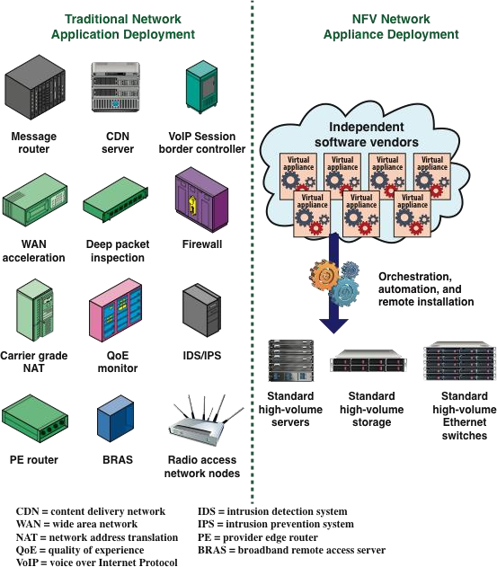
Vision for NFV
Notes:
In traditional networks, all devices are deployed on proprietary/closed platforms. All network elements are enclosed boxes, and hardware cannot be shared. Each device requires additional hardware for increased capacity, but this hardware is idle when the system is running below capacity. With NFV, however, network elements are independent applications that are flexibly deployed on a unified platform comprising standard servers, storage devices, and switches. In this way, software and hardware are decoupled, and capacity for each application is increased or decreased by adding or reducing virtual resources (see Figure 7.5).

Slide 37
Questions?
Notes:
Interesting area to research

